Slide 1
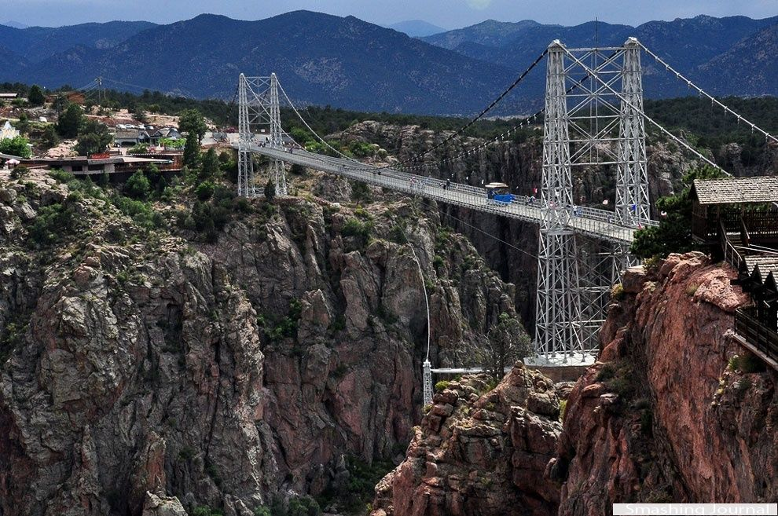
Royal Gorge Bridge
By Alexis

Slide 2
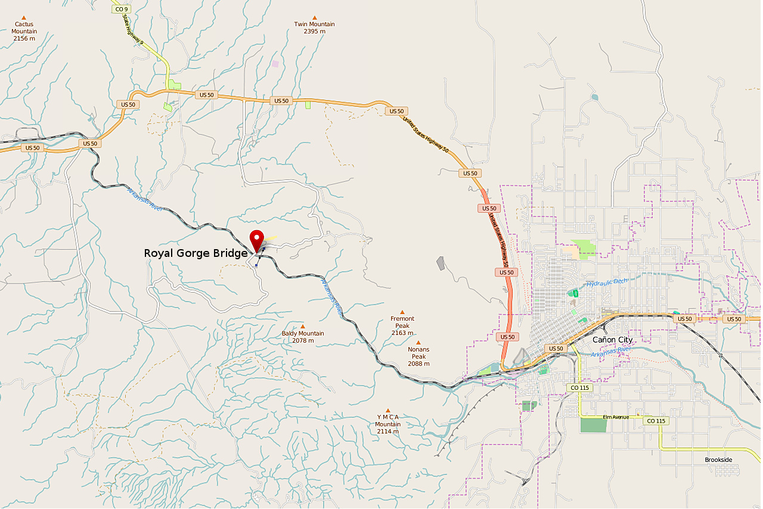
Interesting facts about the Royal Gorge bridge
The bridge is made of 1,292 wooden planks.
The bridge is 955 feet high.
The bridge was built in only seven months time.
The bridge was built in Colorado springs.

Slide 3
COMPARING
SYDNEY HARBOUR BRIDGE LENGTH IS 3,770 FEET
ROYAL GORGE BRIDGE LENGTH IS 1,260 FEET
ROYAL GORGE BRIDGE IS 2,510 FEET SHORTER THAN SYDNEY HARBOR BRIDGE .

Slide 4
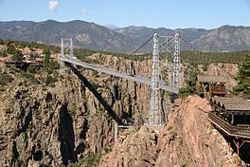
MEASUREMENTS
width of the bridge is 18 feet
height of the bridge is 955 feet
Length is 1,260 feet

Slide 5
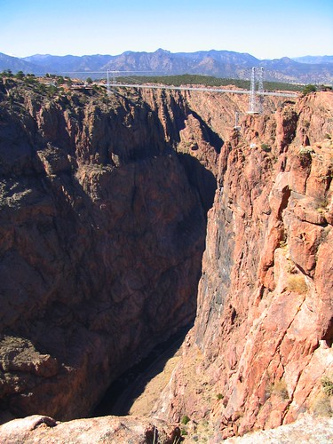
Did you like it ?
Researched and produced by Alexis
3rd grade, Buck Lake Elementary School
Tallahassee. FL

